Slide 1
Smart India Hackathon 2020

Slide 2
Team name : Technothorn
Project name : Ultra-compact Personal Aerial Vehicle

Slide 3
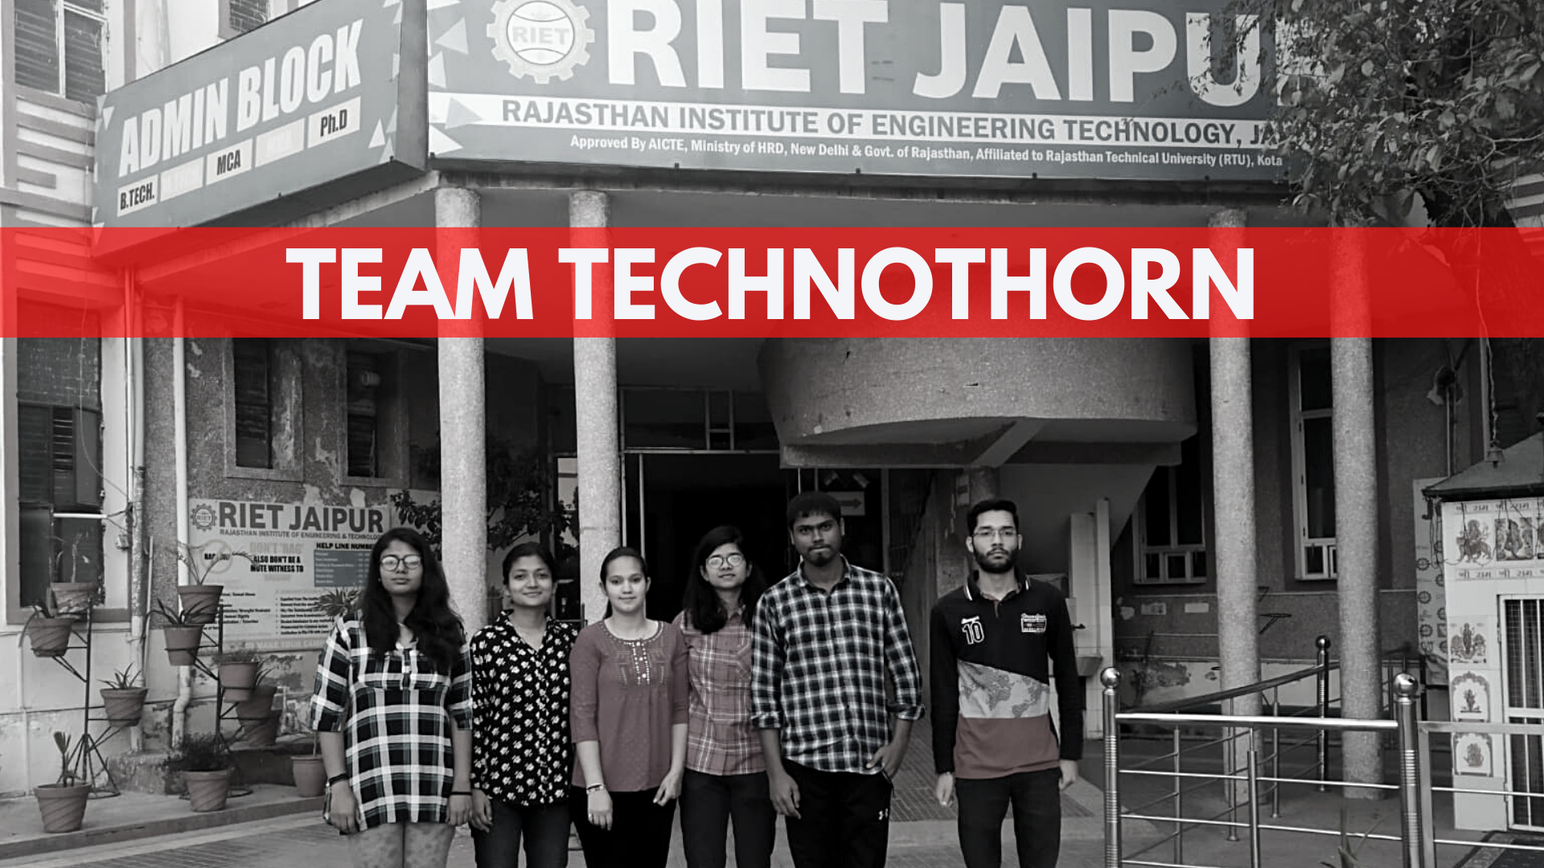
College & Team Info
We the students of Rajasthan Institute of Engineering and Technology, Jaipur visioned for a system which can an ease out the entire concept of traveling in no time.
Our team, Technothorn is the best concoction of innovative thinkers and great illustrators who are competent enough to empower innovation.
We are a team of Data Analysts and Design engineers which is a perfect blend of both the worlds and hence, we are trying to bring thoughts and ideas to reality.

Slide 4
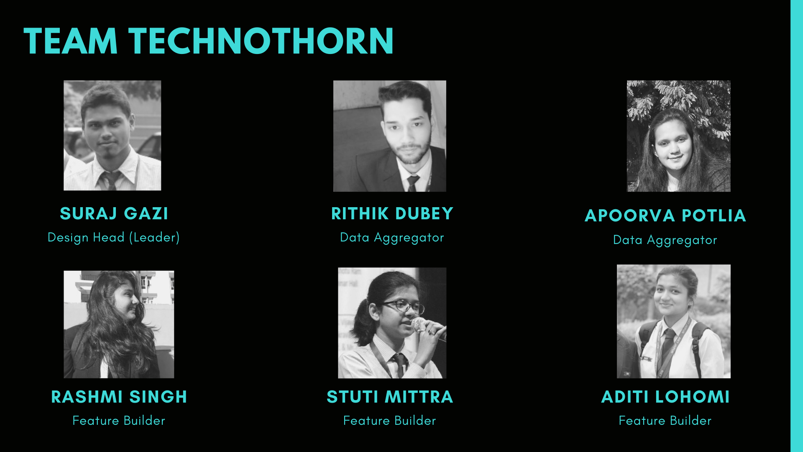

Slide 5
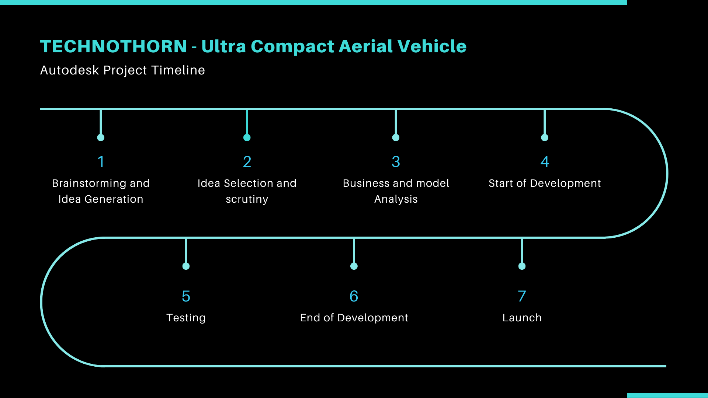

Slide 6
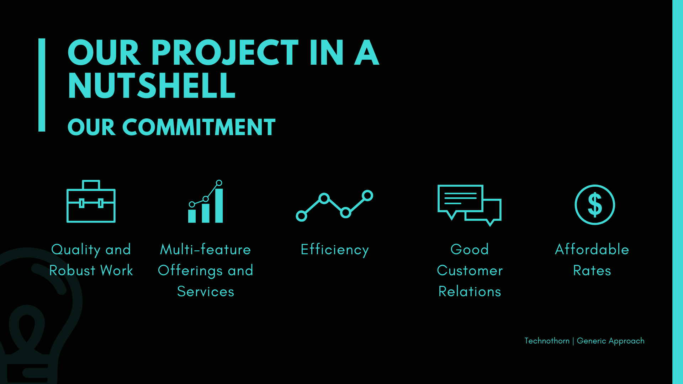
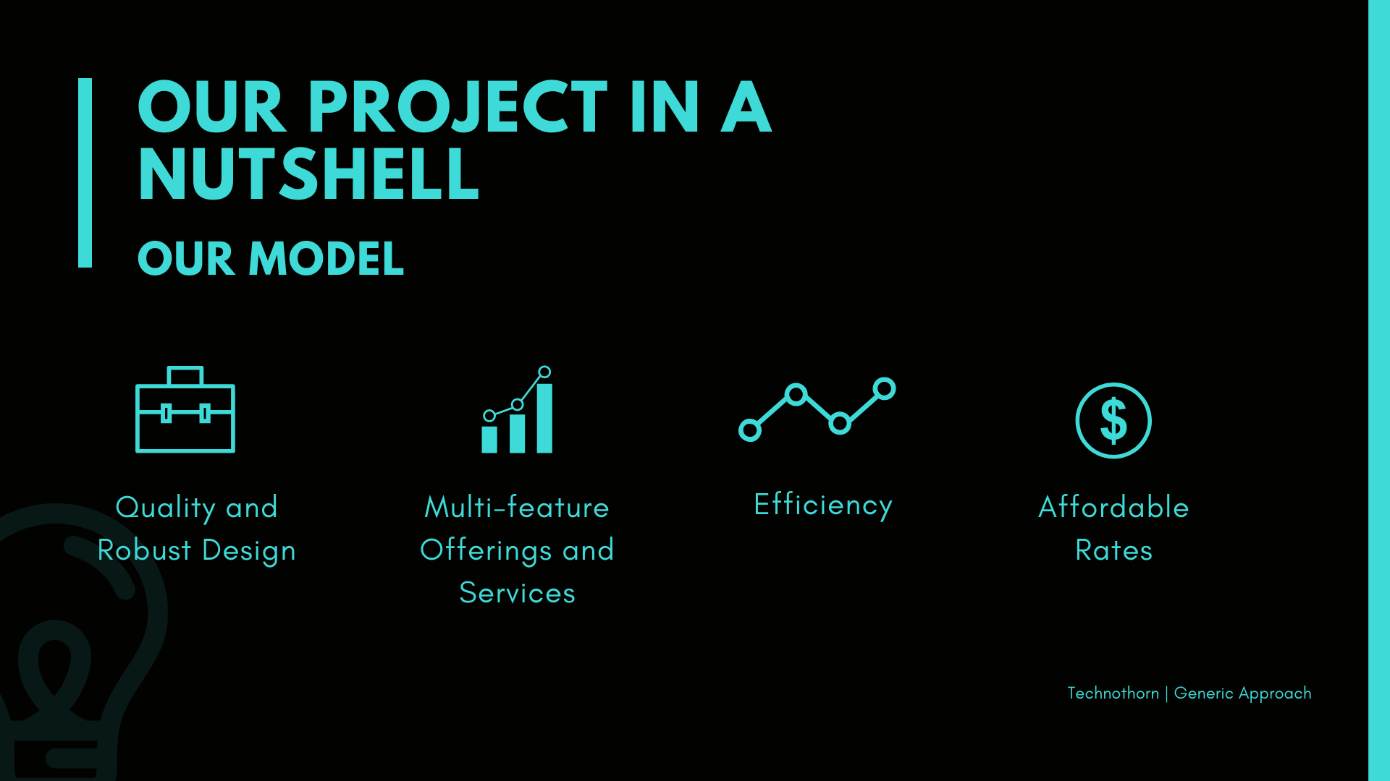

Slide 7
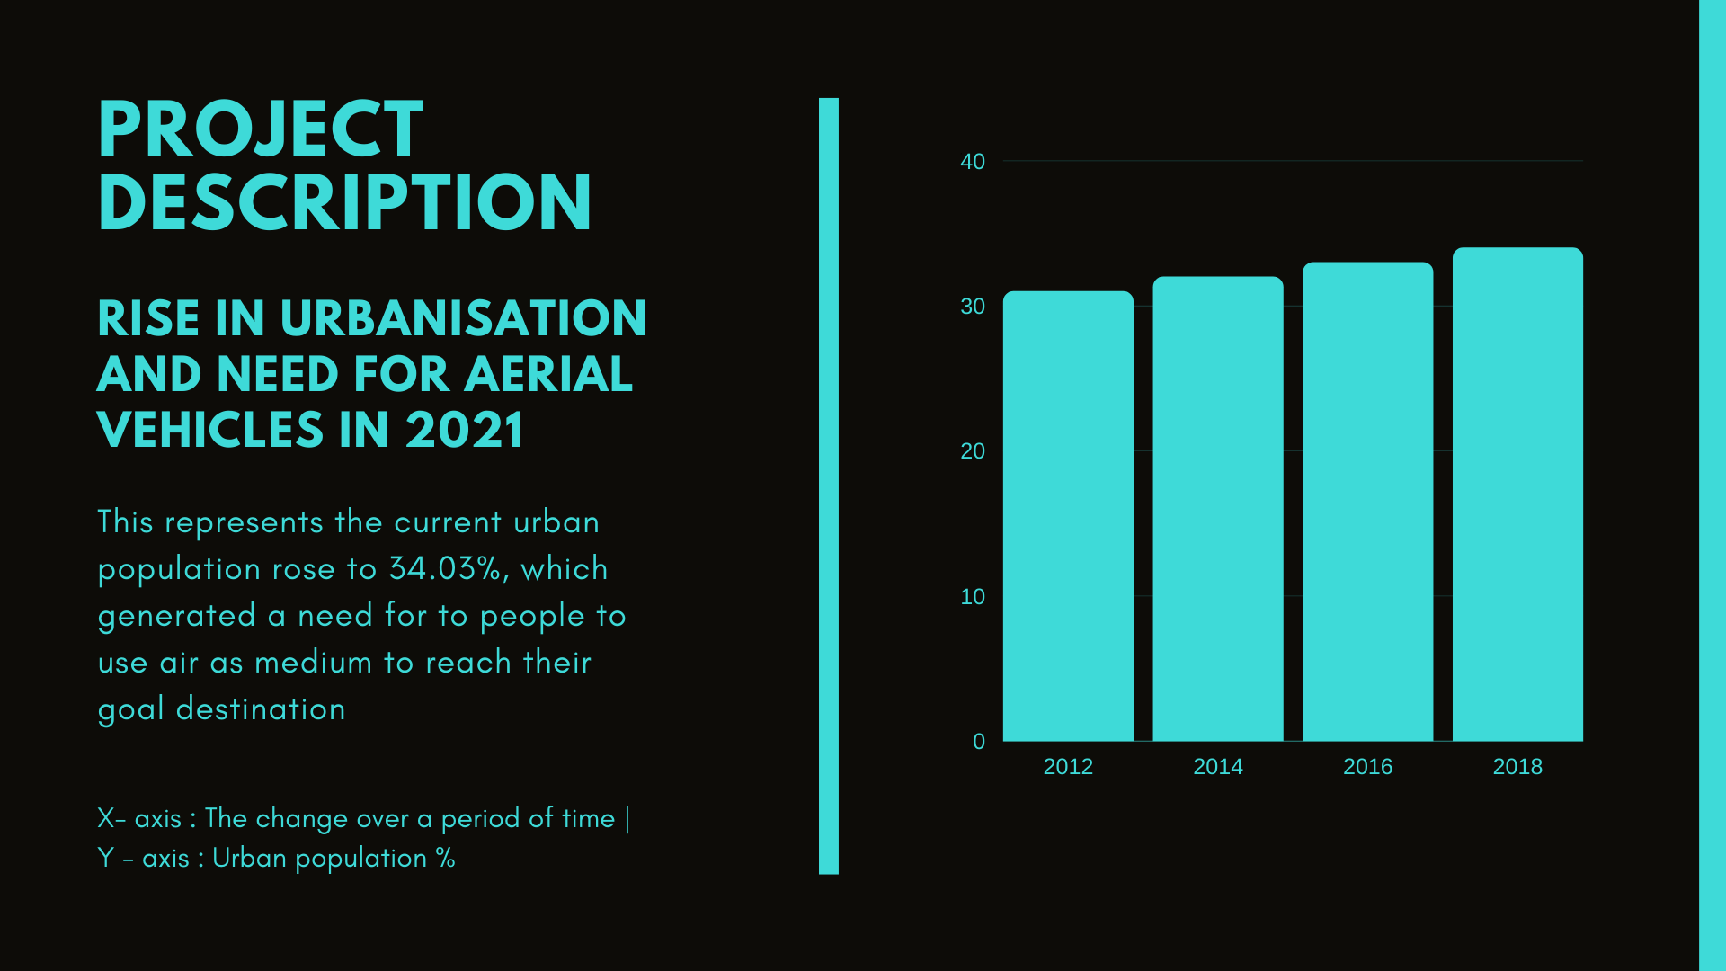

Slide 8
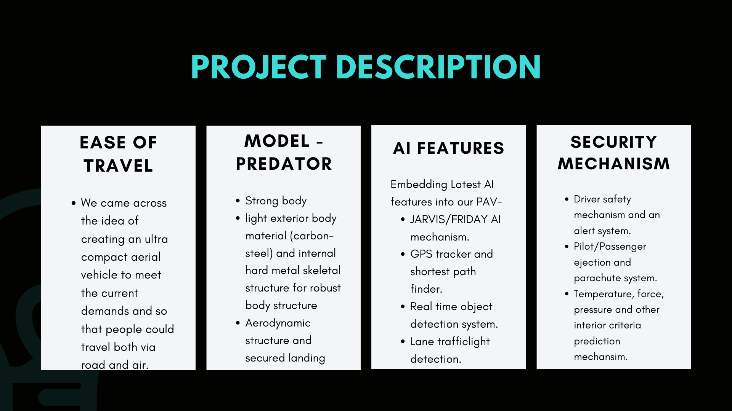

Slide 9
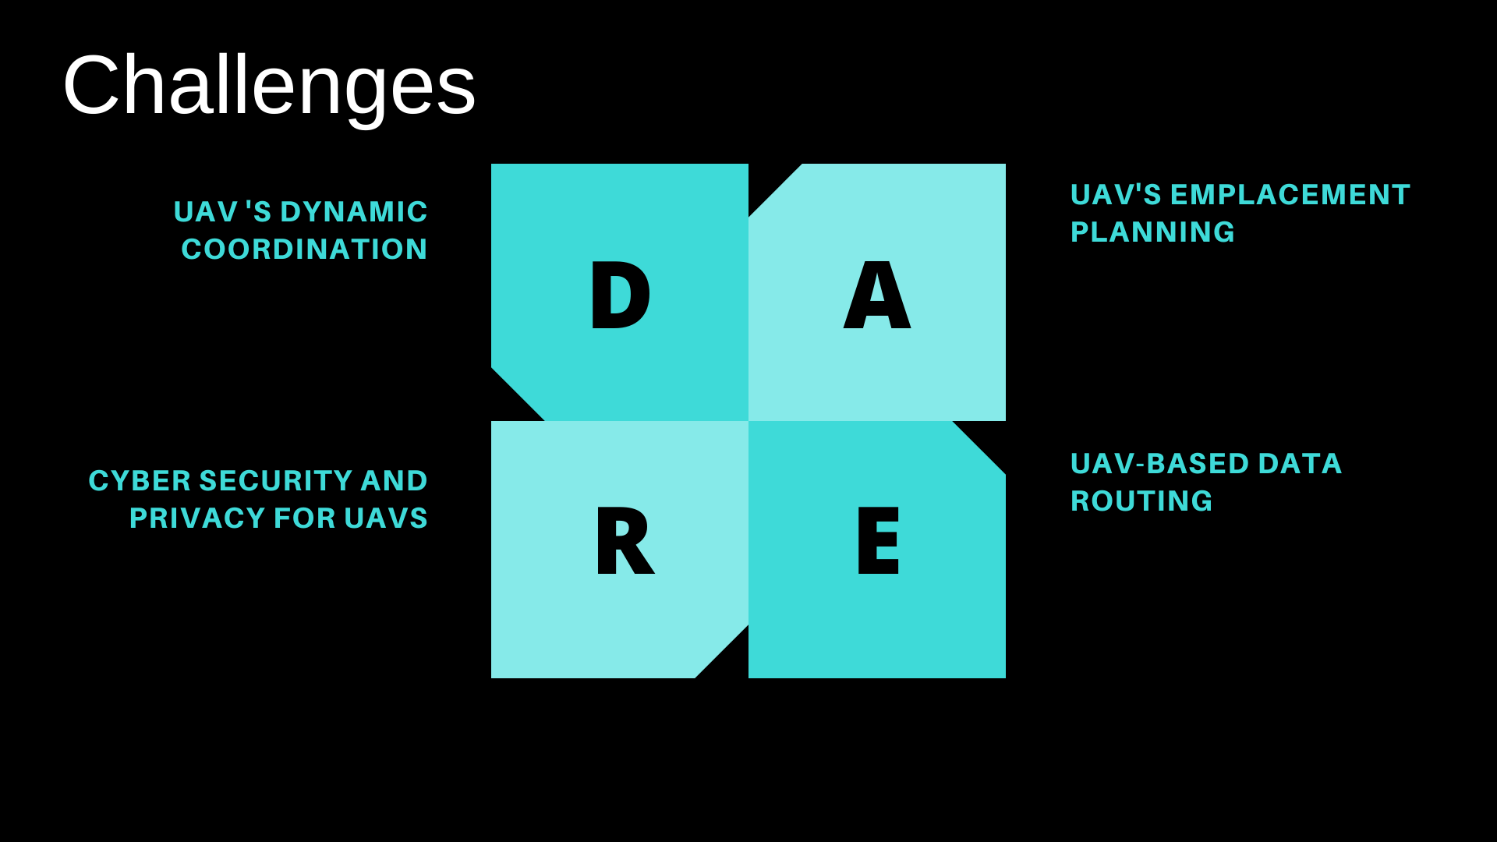

Slide 10
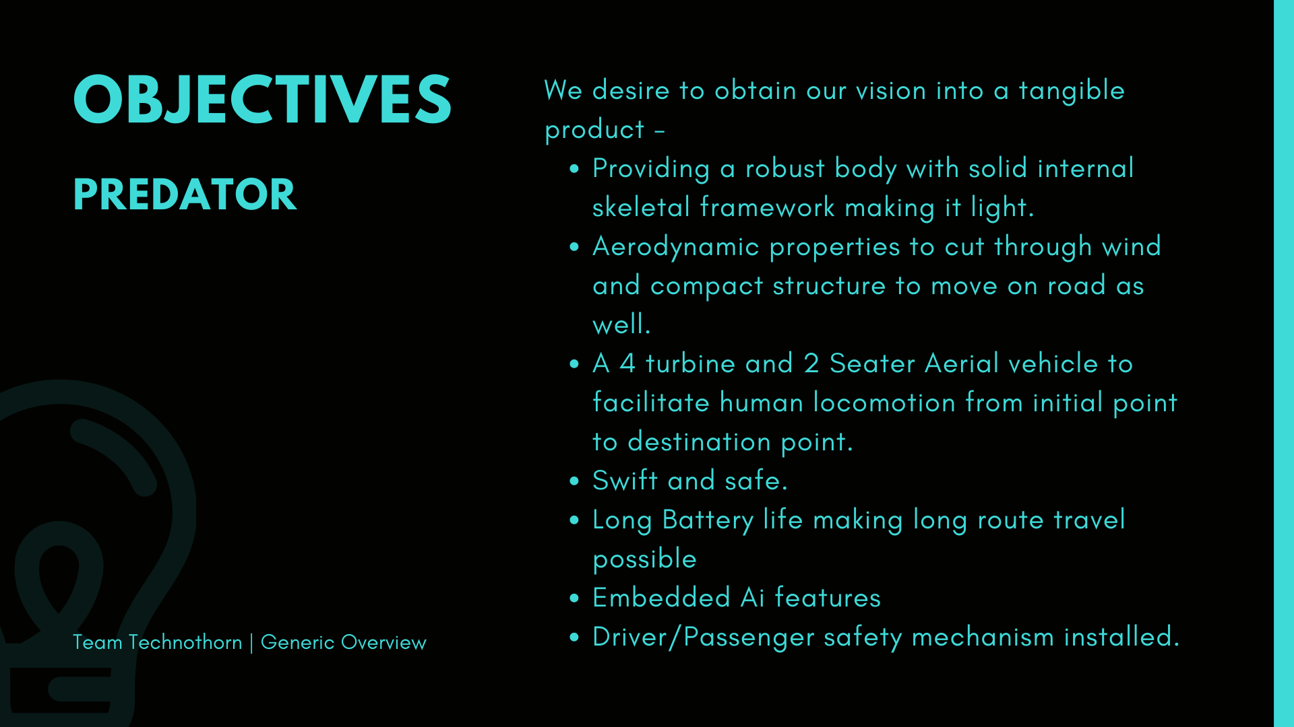

Slide 11
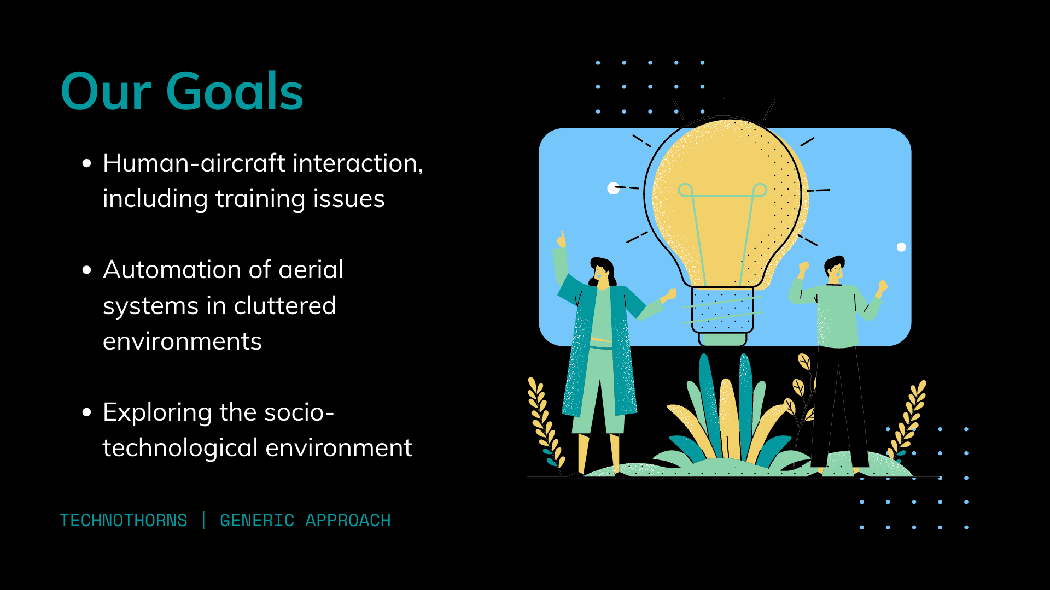

Slide 12
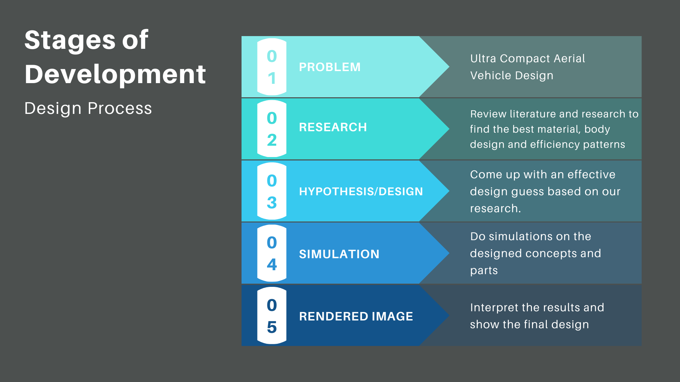
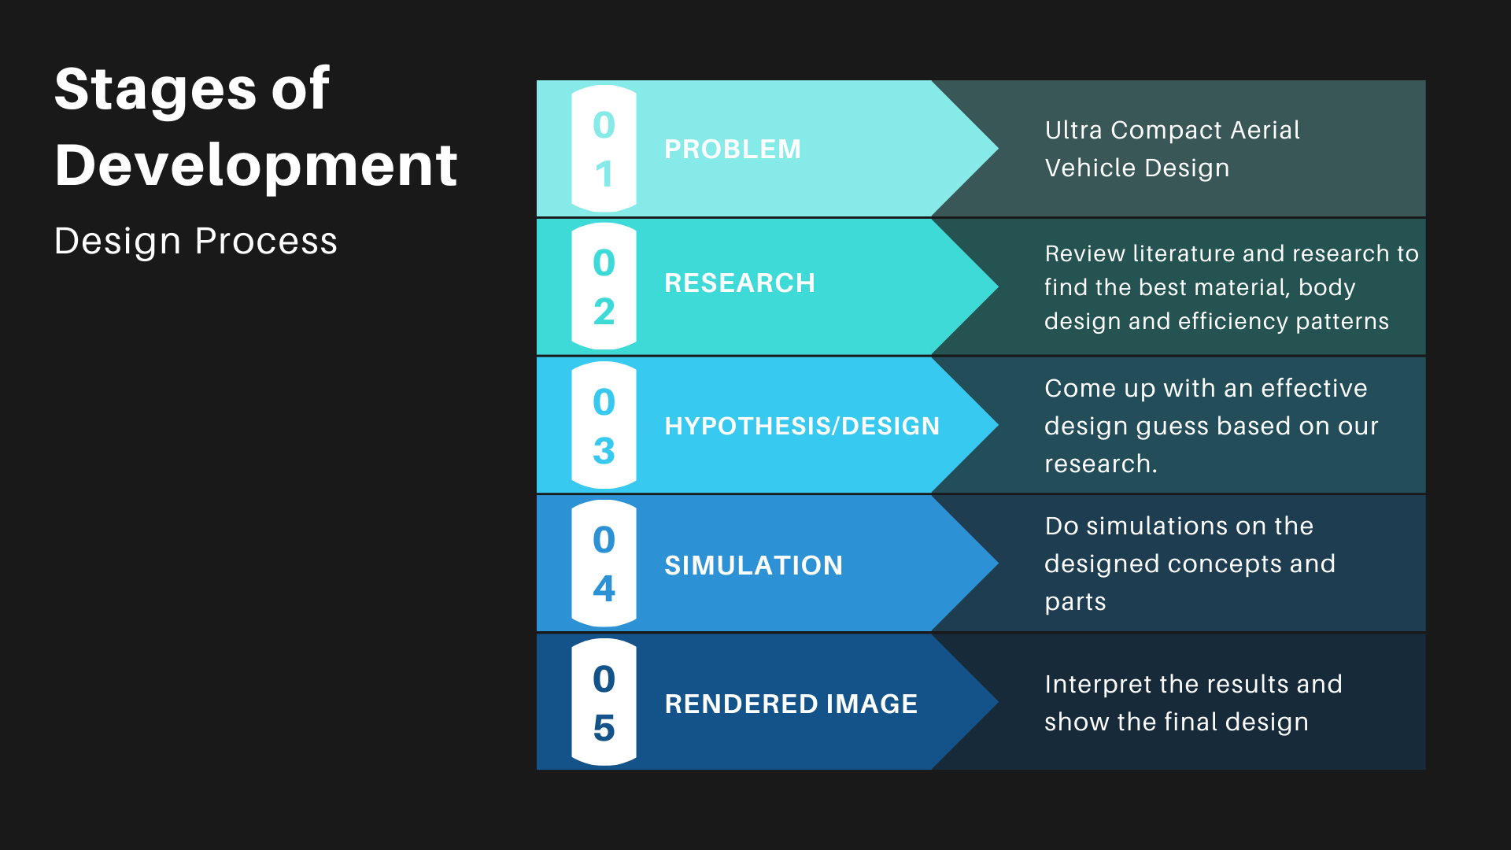
Design Process

Slide 13
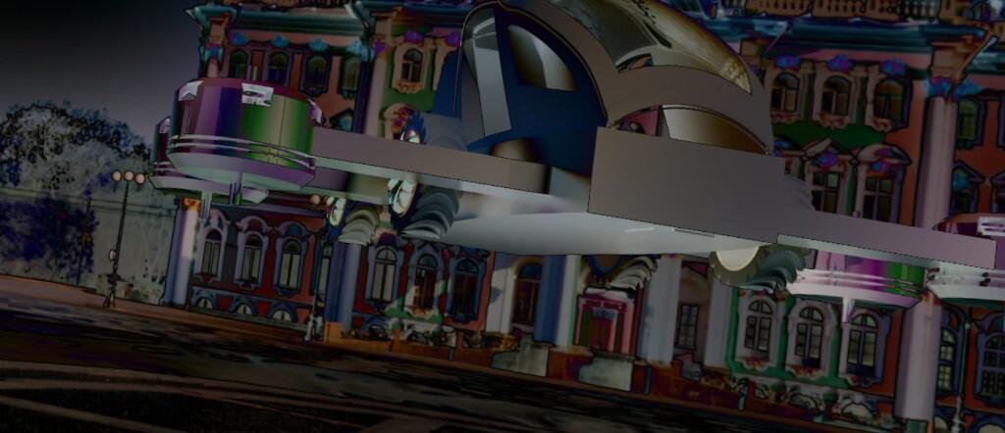
THE PREDATOR

Slide 14
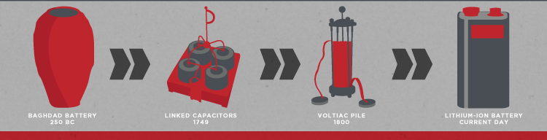
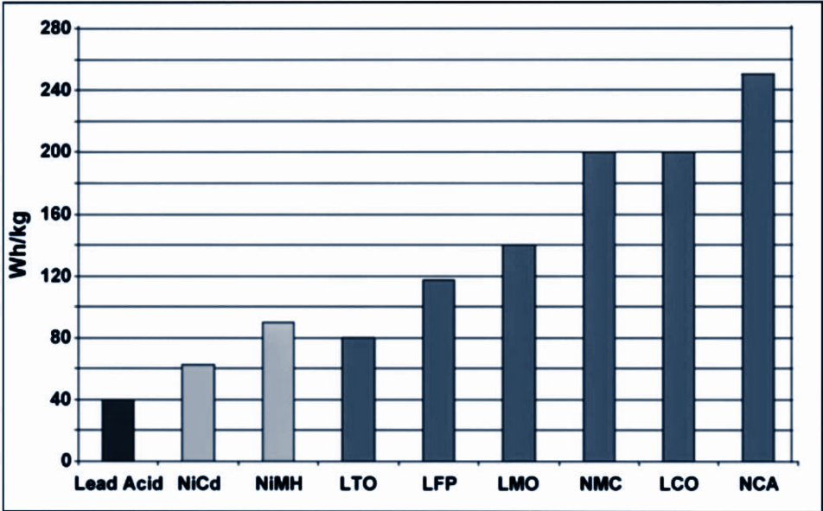
While Li-aluminum (NCA) is the clear
winner by storing more capacity than
other systems, this only applies to
specific energy.
In terms of specific power and thermal
stability, Li-manganese (LMO) and
Li-phosphate (LFP) are superior.
Typical specific energy of lead-, nickel- and lithium- based batteries.

Slide 15
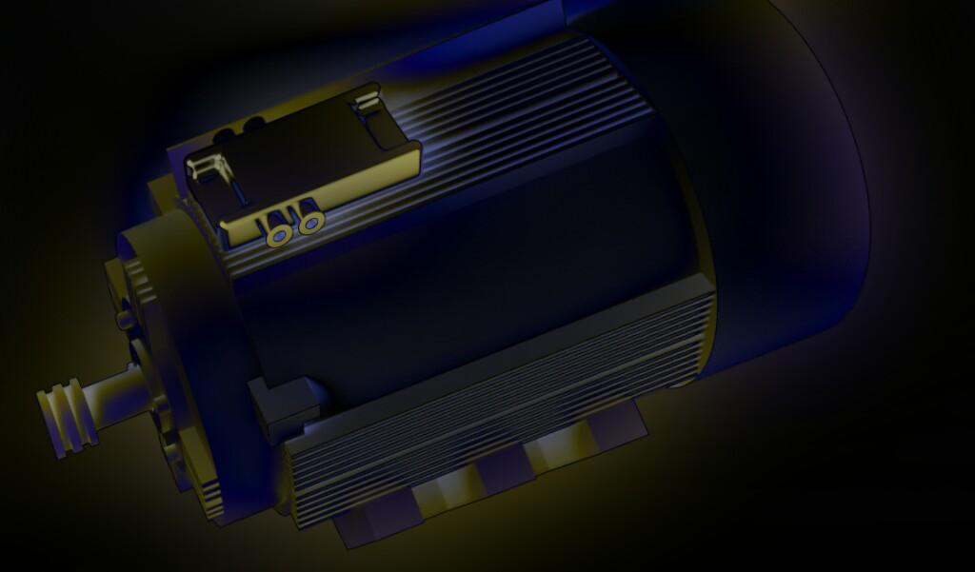
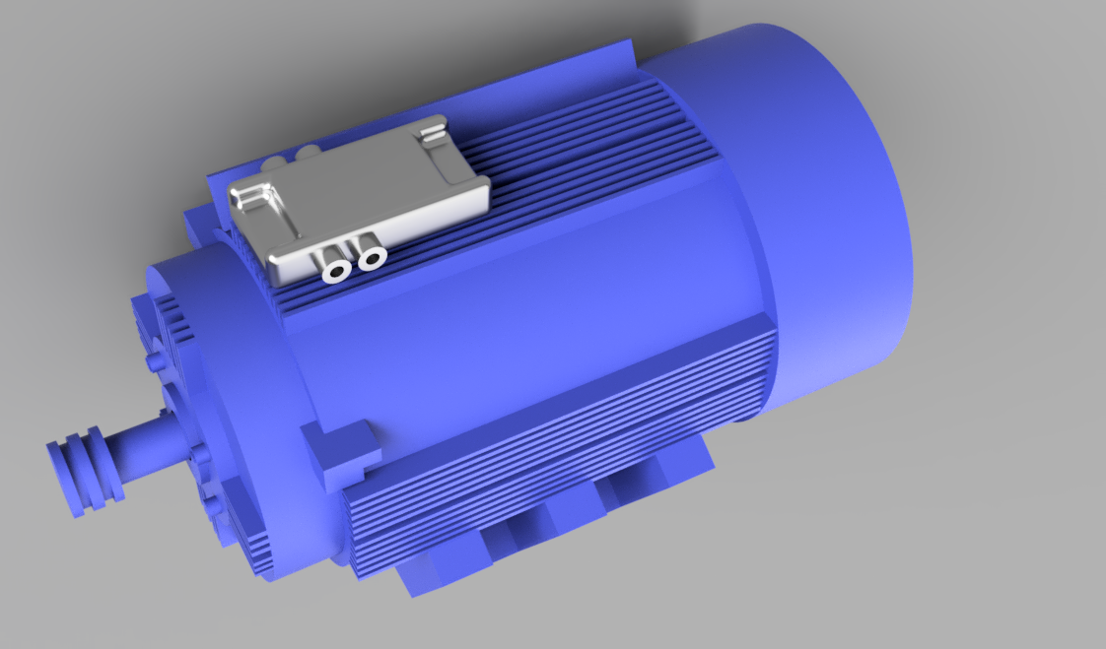
Why Induction motor ?
Rely on Electromagnetism.
90% efficiency.
Skips the extra(polluting) steps.
Materials in it(Li/Co) can be recycled indefinitely.

Slide 16
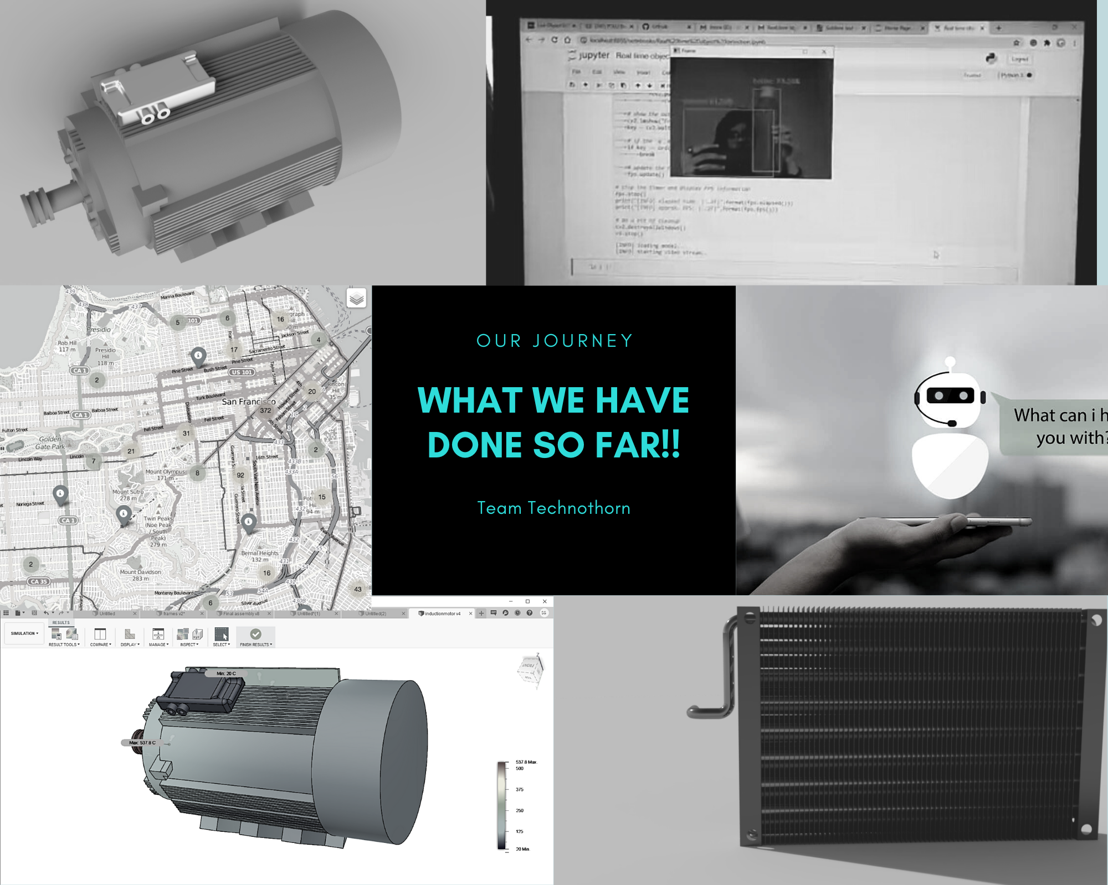

Slide 17
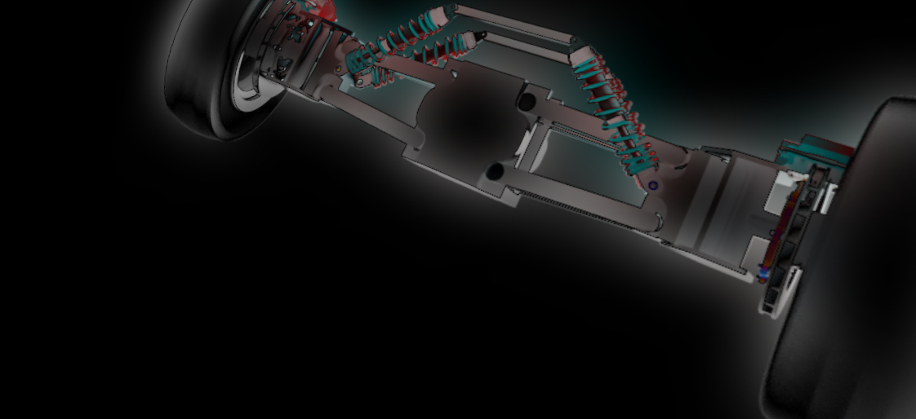
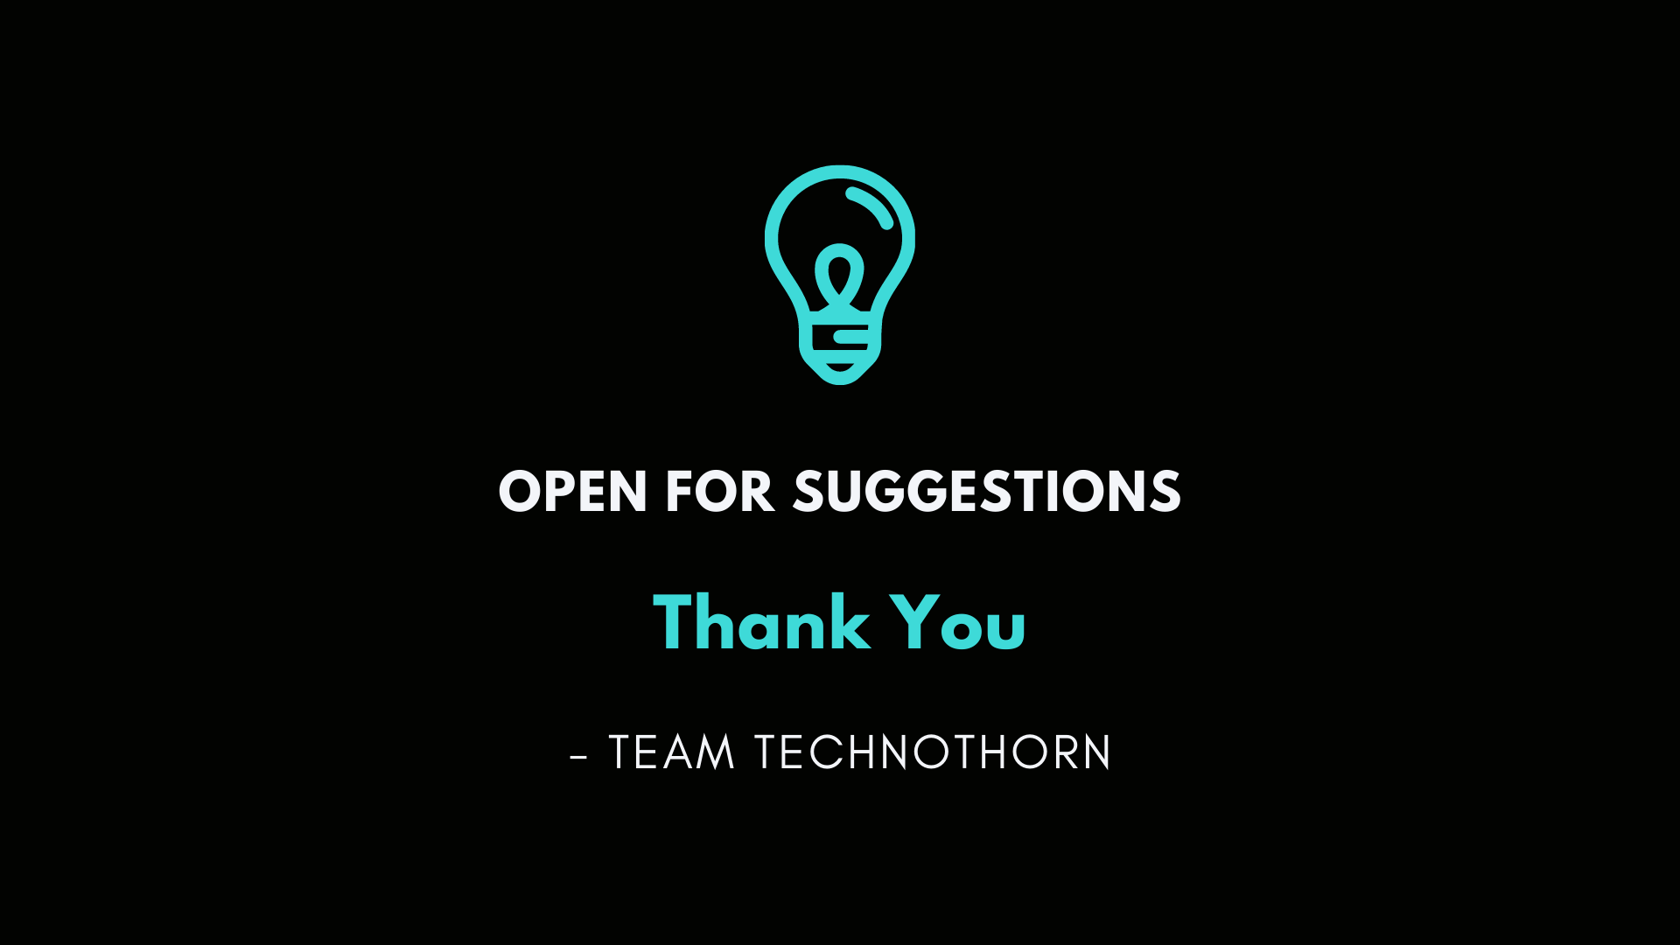
OPEN FOR SUGGESTIONS

